Slide 1
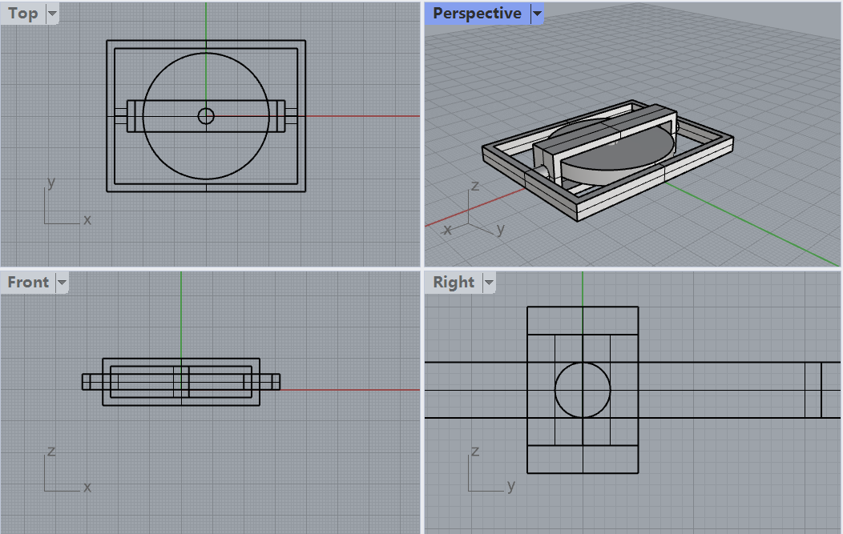
The platform to place camera
Flywheel (rotated by motor), batteries could be placed underneath the inner frame or put on outer frame
Handles connect to this frame

Slide 2
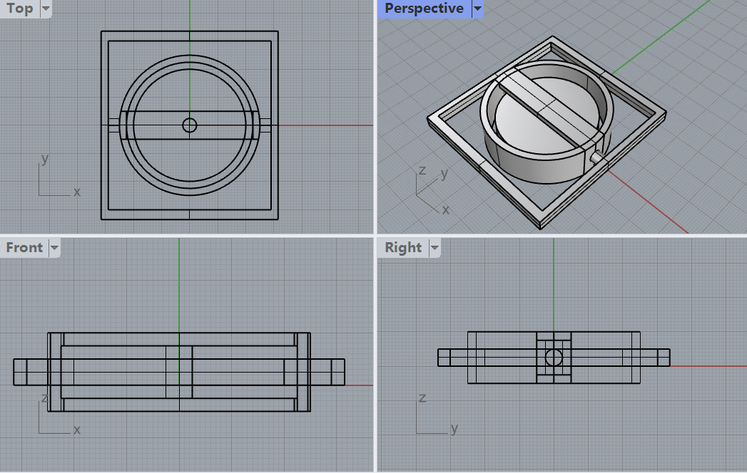
Six coils attached to this frame
Flywheel with magnet

